Slide 1

SIMPLE INTEREST CALULATOR
Presented by :-
Pratibha Walunj
Under the Guidance of :-
Prof. Jayanth V.

Slide 2
AGENDA
OBJECTIVE
LANGUAGES USED
APPLICATIONS
SCREENSHOT
IMPLEMENTATION DETAILS
PROFOUND OUTCOMES

Slide 3


OBJECTIVE
Simple interest is the method to calculate the amount of interest charged on a sum at a given rate and for a given period of time.
The purpose of simple interest calculator is simply calculate the simple interest over their principal, rate and given period of time.
Formula for calculating simple interest :
SI = P * R * T / 100;

Slide 4
LANGUAGES USED
HTML
HTML stands for Hyper Text Markup Language.
HTML describe the structure of a Web page
HTML elements tell the browser how to display the
content

Slide 5
LANGUAGES USED
CSS
CSS stands for Cascading Style Sheet.
CSS describe how HTML elements are to be displayed .
CSS saves a lot of work. It can control the layout of
multiple web pages all at once.

Slide 6
LANGUAGES USED
JAVASCRIPT
JavaScript is the world's most popular programming language.
JavaScript is the programming language of the Web.
JavaScript is easy to learn.

Slide 7
APPLICATIONS
Applications of Simple Interest Calculator:
Calculate principal given rate, interest earned, and time
Calculate the amount of interest earned given the rate, time and principal
Calculate the interest rate given principal, time in months, and interest earned
Determine how much was borrowed to buy a car given interest, rate and time

Slide 8
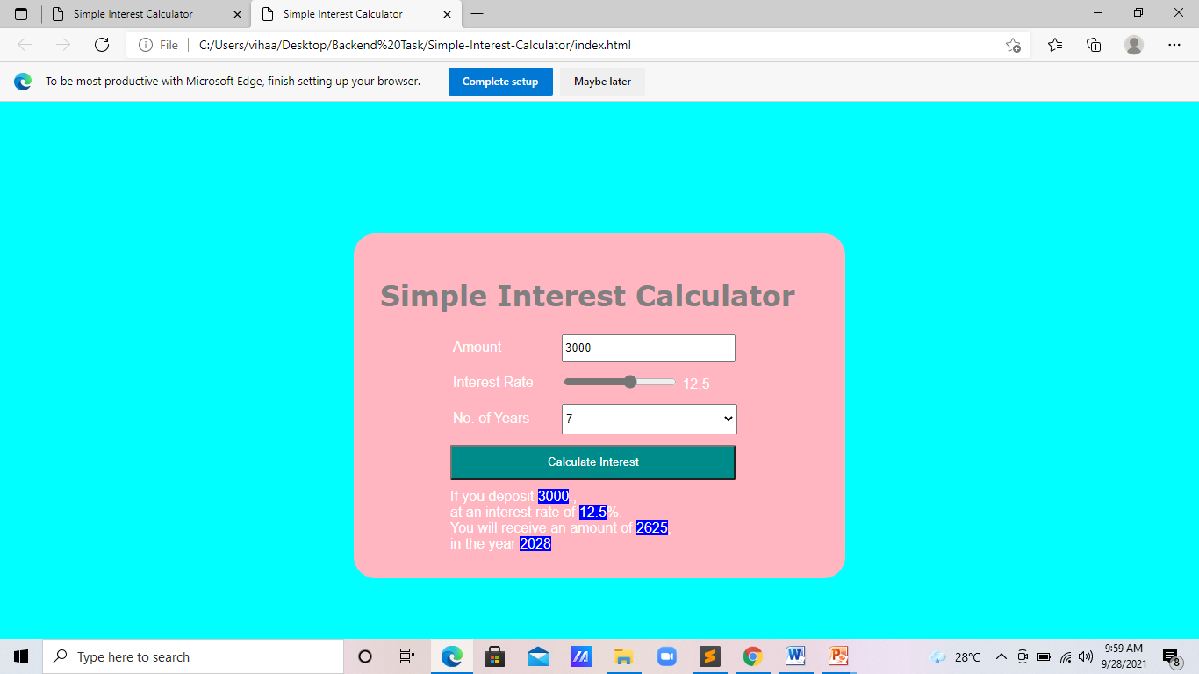

Slide 9
IMPLEMENTATION DETAILS
Software Requirements:-
Operating system: Windows 10
Languages used: Html, css, JavaScript
Editor: Sublime Text
Browser: Google chrome, Microsoft edge
Hardware Requirements:-
Random Access Memory (RAM): 4/8 GB
Device: Laptop , Android Phone

Slide 10
PROPOSED OUTCOMES
By using this simple interest calculator we simply calculate the interest over their principal, rate of interest and the given period of time.

Slide 11
THANK YOU…!
Any Questions.

